Slide 1
Deep Learning Fundamentals For Computer Vision
Notes:
Welcome to Deep Learning Fundamentals for Computer Vision
My name is ____ and this course is designed to be a first day of hands-on experience with Deep Learning. While all of the projects we’ll build will be focused on computer vision, the concepts that we’ll cover are broadly applicable across many deep learning applications, so this is a great place to start no matter what type of problems you’re hoping to solve.

Slide 2
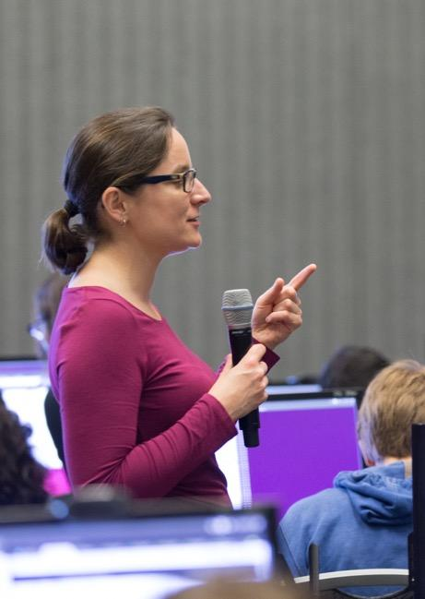
DEEP LEARNING INSTITUTE
DLI Mission
Training you to solve the world’s most challenging problems.
Developers, data scientists and engineers
Self-driving cars, healthcare and robotics
Training, optimizing, and deploying deep neural networks
Notes:
This is one of many offerings from the NVIDIA Deep Learning Institute, or DLI for short. We offer instructor-led and self-paced courses ranging from getting started through cutting edge workflows in specific domains like self-driving cars, healthcare, robotics, etc.
Each of our courses takes advantage of the hands-on platform you’ll be using today which will allow you to start engaging the with tools and concepts that make Deep Learning possible and powerful right from your web browser without the barrier of setting up environments.
Let’s take a look at how this course will flow.
People = Developers, Data Scientist, Engineers
Problems = Self-driving cars, healthcare issues like cancer detection, consumer services and robotics
AI / Deep Learning = training, optimizing and deploying deep neural networks

Slide 3
Training
Deployment
Performance
Train first network
Necessary ingredients for successful training
Role of Neural Networks in Applications
Improving accuracy
Solving novel problems
Changing layers of network
Beyond Image Classification
Building around networks
Improving capability
Introduce Image Classification
This Course: Deep Learning Fundamentals
Notes:
Again, this is meant to be a first hands-on course in Deep Learning where, when you finish, you will be able to identify both the types of problems that are well suited for Deep Learning AND how to think about approaching each of them.
We’ll start by introducing the concept of “training” and how it removes the constraints associated with traditional programming. In doing so, you’ll get your hands on the three ingredients that make deep learning powerful:
Deep Neural Networks
The GPU
Big Data
Next, you’ll learn to “deploy” solutions created with Deep Learning into real-world applications. You’ll see the difference between training environments and deployment environments and be let in on a little secret. You can create applications that use the state-of-the-art in Deep Learning without training models yourself!
Finally, we’ll introduce performance. As you improve your craft, what will you aim to improve? While there is an infinite amount you could learn about improving performance, we’ll highlight the categories of performance to keep in mind by having you experiment with different levers that effect performance.
Each new section you tackle will increase the types of problems where you’re capable of applying Deep Learning.

Slide 4
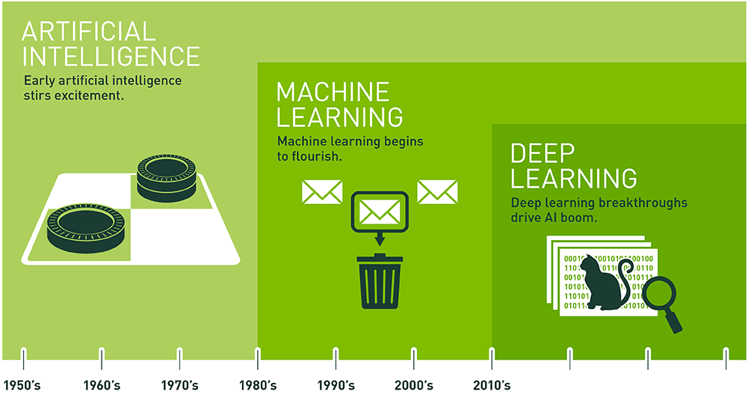
Accomplishing complex goals
Notes:
If we define intelligence as the ability to achieve complex goals, then learning is the ability to achieve more complex goals today than we could yesterday. In this course, you will begin to work with the fundamentals of Deep Machine Learning, using algorithms inspired by the human brain and strategies inspired by human learning to achieve our most complex goals by harnessing the power of parallel computing.
First, let’s start with some definitions…
AI is a broad field of study focused on using computers to do things that require human-level intelligence
It’s been around since the 50’s, playing games like tic-tac-toe and checkers, and inspiring scary sci-fi movies
But it was limited in practical applications
ML is an approach to AI that uses statistics techniques to construct a model from observed data
It generally relies on human-defined classifiers or “feature extractors” that can be as simple as a linear regression
Or slightly more complicated “Bag of Words” analysis that made email SPAM filters possible
Which was really handy in the late 1980’s when lots of email started showing up in your inbox
Ref. https://en.wikipedia.org/wiki/Naive_Bayes_spam_filtering
Then we invented smartphones, webcams, social media services and all kinds of sensors that generate huge mountains of “big data” and the new challenge of understanding and extracting insights from the data.
DL is a ML technique that automates the creation of feature extractors using large amounts of data to train complex “deep neural networks”
DNNs are capable of achieving human-level accuracy for many tasks, but require tremendous computational power to train
A few years ago, researchers started applying DNNs in a variety of areas and reporting amazing results…

Slide 5

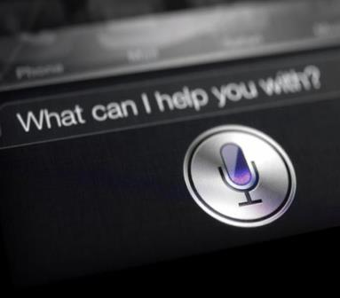

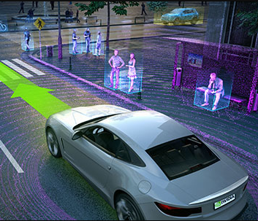

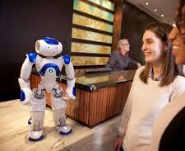

DEEP LEARNING iN PRODUCTION
Speech Recognition
Recommender Systems
Autonomous Driving
Real-time Object Recognition
Robotics
Real-time Language Translation
Many More…
Notes:
You’ve seen Deep Learning in your day to day life. It’s the category of product where you thought to yourself, how’d they do that? Siri, Alexa, and Google Assistant are reducing the barrier to entry to our online world from knowing how to spell and search to knowing how to speak.
Netflix, Amazon, and the DLI’s future homepage allow you to filter through endless categories of offerings to find out what’s right for you.
Combining Computer Vision with control systems opens the door to autonomous machines such as self-driving cars.
I’m sure you can think of other applications.

Slide 6
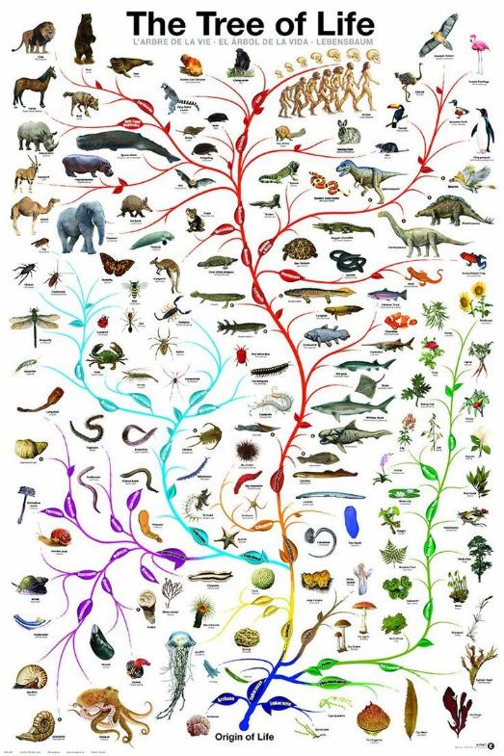
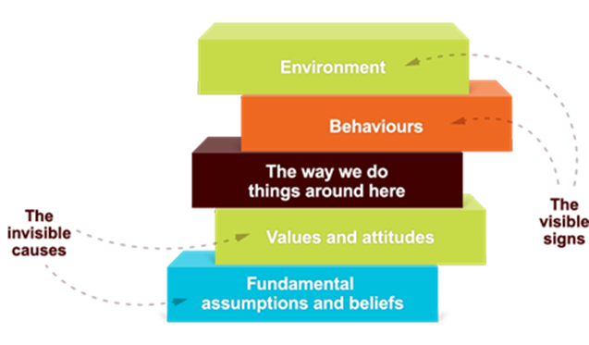

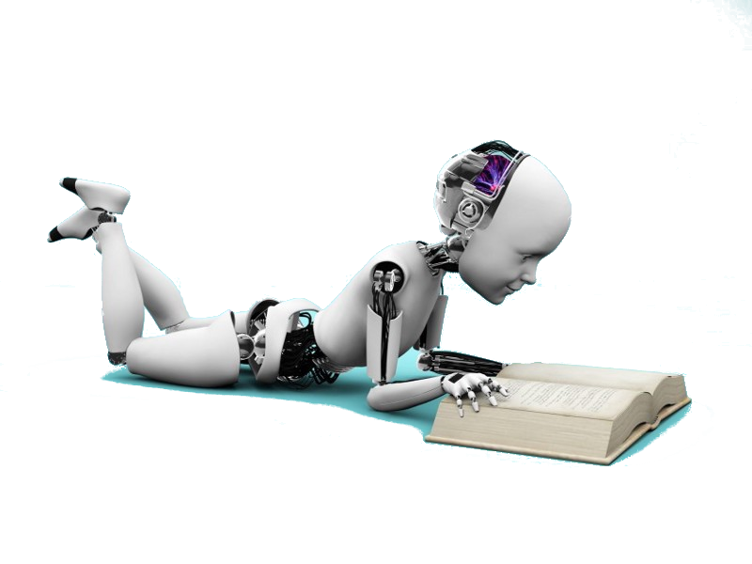
Achieving Complex Goals
4th revolution in knowledge acquisition
1st - Evolution
3rd - Culture
2nd - Experience/Brain
4th – Machine Intelligence
Notes:
You may may have heard AI described as a “fourth industrial revolution,” “life 3.0,” “the new electricity,” etc. The excitement the community is feeling is based on an entirely new way of acquiring knowledge.
Early life learns, or becomes capable of achieving more complex goals, once per species. A plant evolving with bigger leaves to collect more sun might be capable of surviving in climates with less sun than their predecessors, or with spikes survive where there are animals.
More complex life learns, or becomes capable of achieving more complex goals, within a lifetime. Born with the ability to learn, experience increases capability.
Humanities early cultural innovations, language, text, the internet allow knowledge to be shared, again accelerating the pace of learning and accelerating our ability to achieve increasingly complex goals.
Machine learning is exciting for the ability to connect ideas from ALL of humanities combined knowledge. Learning our history from reading Wikipedia, our math from Khan Academy, and our culture from YouTube, all in parallel.
The hope/bet is, this will increase our pace of knowledge acquisition again, allowing us to set out sights on once impossible goals.
So we’ve defined intelligence and identified some of the goals that artificial intelligence is helping us to meet, let’s introduce deep learning specificically.

Slide 7
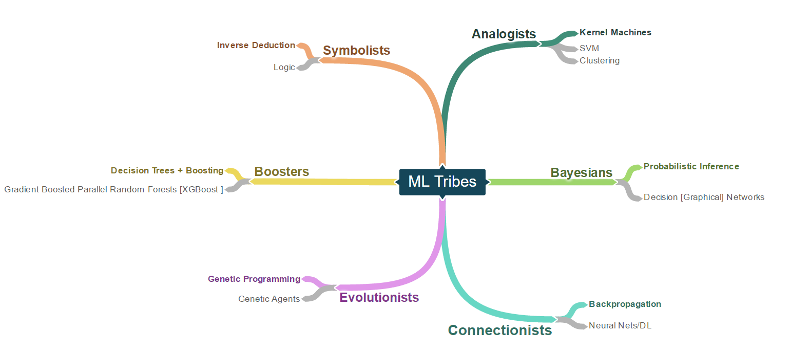
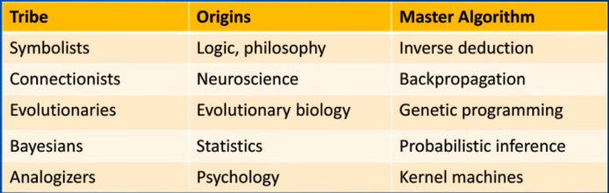
ML Tribes
Notes:
This is a high-level overview:
When creating algorithms inspired by human learning, you can imagine there are many different schools of thought. If I asked you how you learn, you might point to logic, your brain, your evolved biology, statistics, psychology, or countless other drivers. Each of these “tribes” has developed a “master algorithm” that emulates that “learning” mathematically. Eg. Researchers who attribute human learning predominantly to logic use something called Inverse Deduction, etc.
We’re not going to go into all of these today, but will be focused on the connectionists who use a technique called backpropagation. Why? Let’s find out.

Slide 8
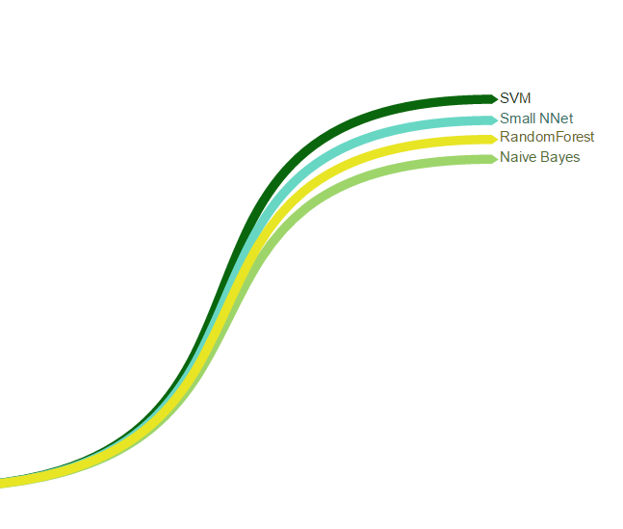
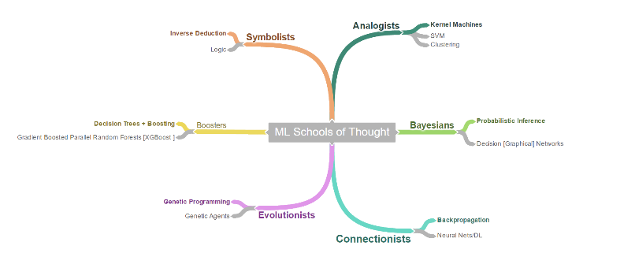
Trend #1 [ Scale ]
Performance
Exponential Growth of Data
Somewhat Arbitrary Ordering of Model Performance
[ based on hand engineering effort ]
1990
2000
2010
Data
Notes:
Until about 2010, each of these methodologies returned fairly similar performance. On the x axis, you see two variables: dataset size and time, on the y-axis, performance however it is measured signifying use on new data.
Around 2010, a few things changed…

Slide 9


Trend #1 [ Scale ]
Performance
1990
2000
2010
2017
2020
Data
Notes:
Any ideas?

Slide 10
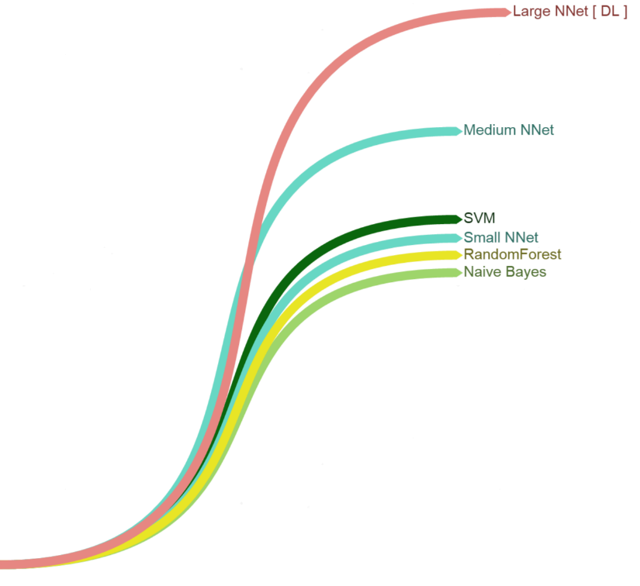
Trend #1 [ Scale ]
Performance
1990
2000
2010
2017
2020
Data
Notes:
Pull from the audience here…
Look for and guide towards:
Deeper networks
More data
The GPU

Slide 11

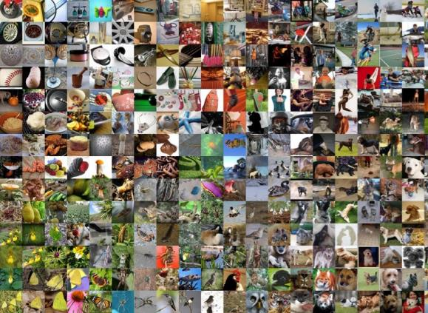

THE BIG BANG IN MACHINE LEARNING
DNN
GPU
BIG DATA
Notes:
This slide is at the core of everything we will be discussing. During the presentation, references to the “Big Bang” slide should be made as this slide is the basis for why companies need GPUs.
What is it that caused this revolution in Machine Learning? Three things happened at nearly the same time that enabled revolutionary advances in Machine Learning.
First, improvements in the solvers of Deep Neural Networks (DNN) and techniques such as the Convolutional Neural Network (CNN) made their use more tractable.
Significant advancements with DNNs started with AlexNet architecture in 2012
Second, the big data movement has provided the data necessary to train deep networks.
2.5 quintillion bytes of data produced each day
With the introduction of social media there has been a proliferation of data – primarily images and text
Third, the GPU has provided the computational power necessary to solve DNNs in reasonable amounts of time
GPUs allow Data Scientist to build better models faster. Data Scientist can run more trial and errors using GPUs than with CPUs
Models can make decisions faster using GPUs
GPUs can be 2X to 10X faster than CPUs

